Slide 1
Graph Neural Networks: Foundations, Message Passing, and Real-World Applications
Sidharth SS (IISER, Mohali)
27-03-2025
‹#›

Slide 2
Outline
Graph Basics:
Nodes, edges, and adjacency matrices
Message Passing:
Aggregation & update functions
Key Applications:
Graph/node classification, link prediction, computer vision
Challenges
Summary
‹#›
‹#›

Slide 3
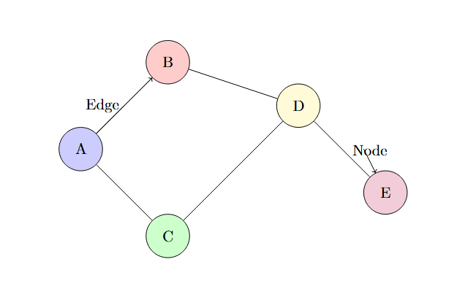
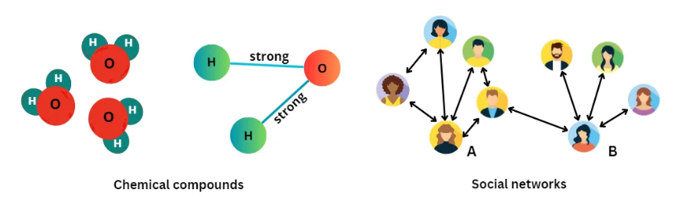
What Is a Graph?
A graph is simply a set of objects (nodes) connected by relationships (edges).
Eg: Social networks, transportation systems, molecules.
‹#›

Slide 4
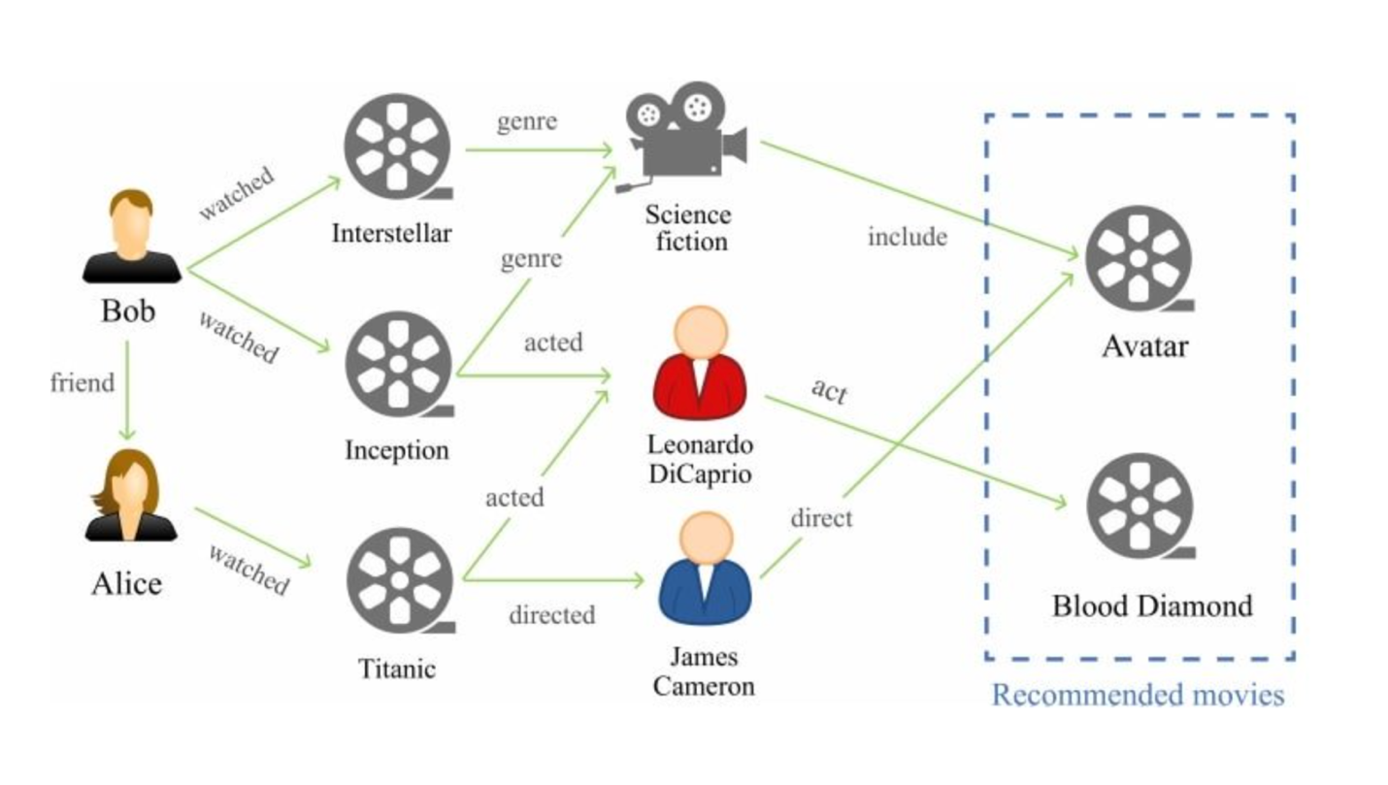
Why Graphs?
Graphs capture complex relationships that may be hidden in raw data.
Can handle heterogeneous data (different types of nodes and edges), making them suitable for dynamic systems.
Applied in real-world scenarios such as recommendation systems, fraud detection, protein-protein interaction networks, and traffic optimization.
Image Source: https://hackread.com/enhancing-systems-collaborative-graph-neural-networks/
‹#›

Slide 5

Representing Graphs Mathematically
A graph is defined as:
where:
V is the set of nodes (e.g., users in a network).
E is the set of edges representing relationships or connections.
‹#›

Slide 6
Extracting Information from Graphs
How do we leverage the structure of a graph to gain insights?
Graphs store information in two main ways:
Nodes contain properties like mass in a chemical molecule, user attributes in a social network, or airport locations in a flight network.
Edges store relationships, such as bond types in molecules, friendships in social networks, or flight connections between cities.
Extracting insights requires analyzing both node and edge features to uncover patterns
‹#›

Slide 7
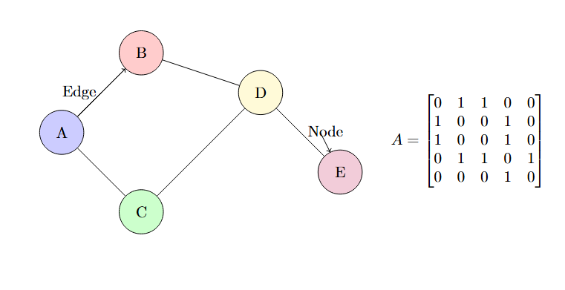
Extracting Information from Graphs
Graphs can also be represented using an adjacency matrix, where:
Rows and columns represent nodes.
A value of 1 indicates an edge between two nodes, while 0 means no edge.
‹#›

Slide 8

Representing Graphs Mathematically
Node Feature Vectors
Each node i has a feature vector:
where d is the feature dimension.
Adjacency Matrix
The Adjacency Matrix A stores graph connectivity:
‹#›

Slide 9
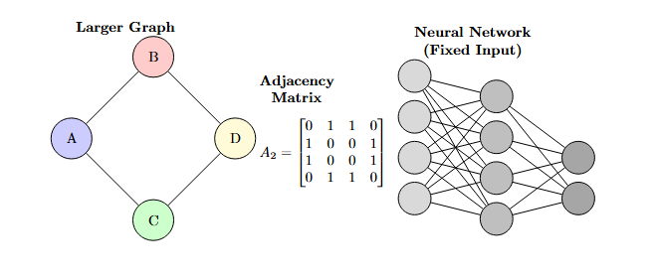
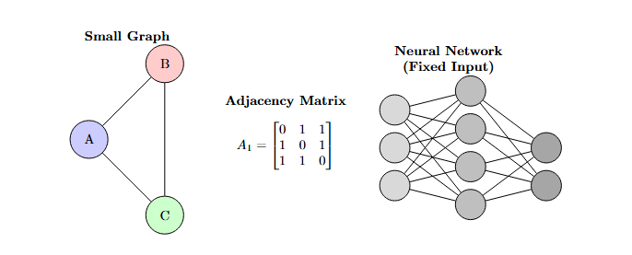
Challenges in Using Graphs for NNs
Graphs Have Variable Sizes:
A graph can be small (e.g., a molecule with 5 atoms) or large (e.g., a molecule with 50 atoms), leading to adjacency matrices of different dimensions.
Standard feedforward neural networks require fixed-size inputs, making it impossible to directly feed all graphs into the same NN without special techniques.
‹#›

Slide 10
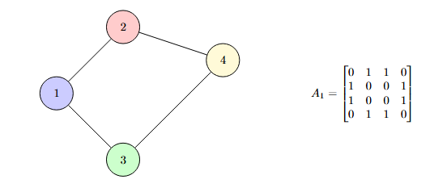
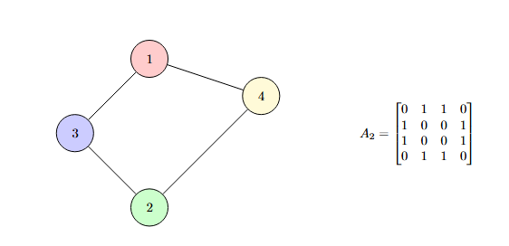
Challenges in Using Graphs for NNs
No Canonical Ordering of Nodes:
Unlike images (which have a fixed grid structure), graphs don't have a natural order of nodes. This means the adjacency matrix can change based on how nodes are indexed, making it not permutation-invariant.
‹#›

Slide 11
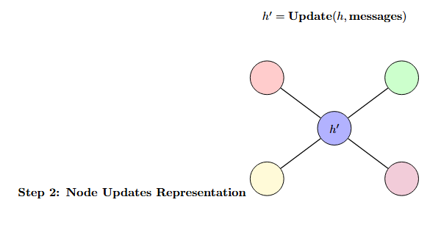
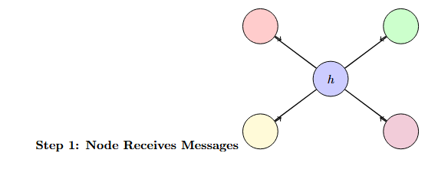
The Message Passing Paradigm
Goal:
The primary objective of the message passing paradigm in graph neural networks (GNNs) is to update each node’s representation by aggregating information from its neighbors. This allows nodes to capture structural and relational patterns within the graph.
‹#›

Slide 12
The Message Passing Paradigm
How It Works:
Message Passing: Each node gathers information from its connected neighbors.
Aggregation: The collected information is combined using functions like sum, mean, or more complex neural operations.
Update: The node's representation is updated based on the aggregated information.
Repeat: The process continues for multiple iterations, allowing distant nodes to influence each other over time.
‹#›

Slide 13

Message Function
For each node j sending a message to node i, we define the message function as:
where x_{j} is the feature vector of node j.
A common choice for F (x_{j} ) is an affine transformation:
where:
• W is a learnable weight matrix,
• b is a bias term.
For each , we apply a transformation to the neighbor ‘s feature vector
If x_{j} has d features, its shape is R^{d}
‹#›

Slide 14

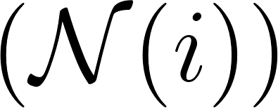
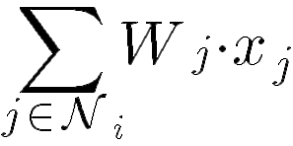
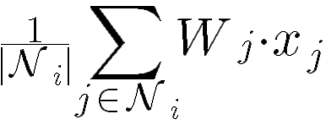

Message Aggregation
A general message aggregation function G can be written as:
where is the set of neighbors of node i. Common choices for G include:
Sum
Mean
Max
These functions ensure permutation invariance, meaning the aggregation result does not depend on the ordering of the neighbors.
‹#›

Slide 15
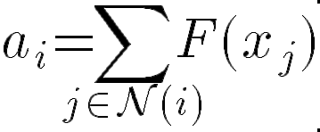
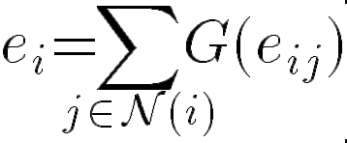
Update Function
To update a node’s representation, we combine its own features with aggregated messages from its neighbors and incorporate edge features:
where: - x′_{i} is the updated node representation
- x_{i} is the original node feature vector
- a_{i} is the aggregated message
- e_{i} represents aggregated edge features
- H and K are transformation functions
- σ is a non-linearity such as ReLU or Sigmoid
K(H(x_{i}), a_{i}, e_{i}) is a combining function (which could itself be a neural network layer) that fuses the
transformed node feature, the aggregated neighbor messages, and the aggregated edge features.
‹#›

Slide 16
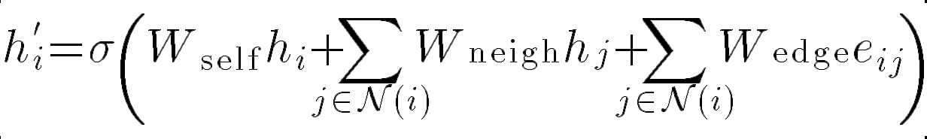
Simplified Formulation
A commonly used formulation in Graph Neural Networks (GNNs) is:
where: - W_{self}, W_{neigh}, W_{edge} are learnable weight matrices for self-information, neighbors, and edge
features respectively
‹#›

Slide 17
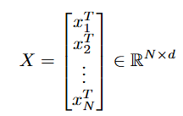



Let’s Vectorize
Now that we have all the necessary components, we need to structure them for practical implementation in code.
Each node i has a feature vector x_{i} of shape R^{d}, where d is the number of features. Stacking all N node features together forms the feature matrix:
For transformation during message passing, we introduce a weight matrix
W with shape:
where d′ is the output (hidden) dimension. The transformed feature representation is then given by:
which results in a new node feature matrix:
‹#›

Slide 18



Let’s Vectorize
To incorporate edge embeddings, we use the adjacency matrix A, which has the shape:
where A_{ij} represents the connection between node i and node j. The message-passing step then becomes:
Where:
The original adjacency matrix A represents connections between different nodes, but does not include self-connections (i.e., A_{ii}=0 for all i).
Adding the identity matrix I ensures that each node includes its own features in the message passing update, allowing information to propagate more effectively.
‹#›

Slide 19
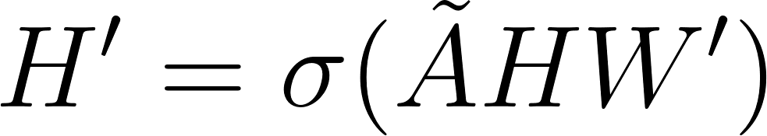
Let’s Vectorize
After computing the transformed node representations, we apply a non-linear activation function σ to introduce non-linearity into the model:
which can be further passed to subsequent layers:
‹#›

Slide 20
Applications of Graph Neural Networks
Graph Neural Networks (GNNs) have several key applications, including:
Graph Classification
Node Classification
Link Prediction
‹#›

Slide 21
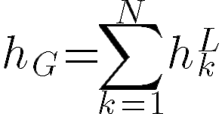
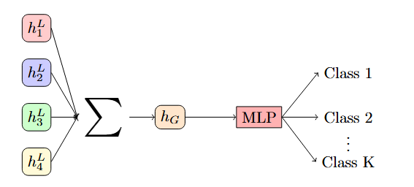
Graph classification
To obtain a representation of the whole graph, we aggregate node embeddings along the first axis:
Where:
k is the index representing each node in the graph.
N is the total number of nodes in the graph.
h^{L}_{k} is the node representation at the final layer L. The aggregated graph representation is then passed through a Multi-Layer Perceptron (MLP) for classification.
Eg: Predicting the type of a molecule based on its structure
‹#›

Slide 22
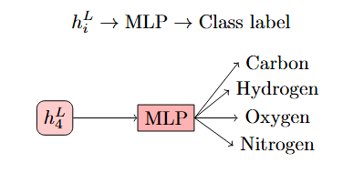
Node Classification
To classify individual nodes, we use their final layer representations:
Example: Identifying the role of a user in a social network.
Each node in a graph represents a user, and the goal is to classify them as spammer vs. legitimate user, influencer vs. regular user, or bot vs. human.
Real-world Use Case: Fraud detection in social networks, where GNNs classify users based on their connectivity and interaction patterns.
‹#›

Slide 23
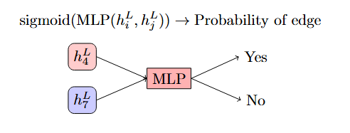
Link Prediction
Given node embeddings h^{L}_{i} and h^{L}_{j} , we determine whether an edge exists between them using an MLP with a sigmoid activation:
‹#›

Slide 24
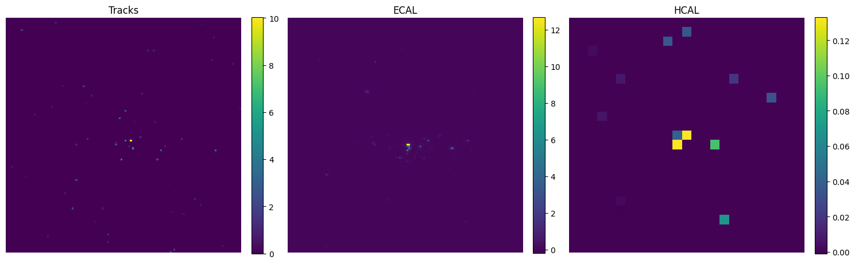
GNN for CV : Quark–Gluon Classification
Problem: Classify jets into two classes: quark jets and gluon jets.
Each jet image comprises three channels:
Tracks
ECAL
HCAL
‹#›

Slide 25
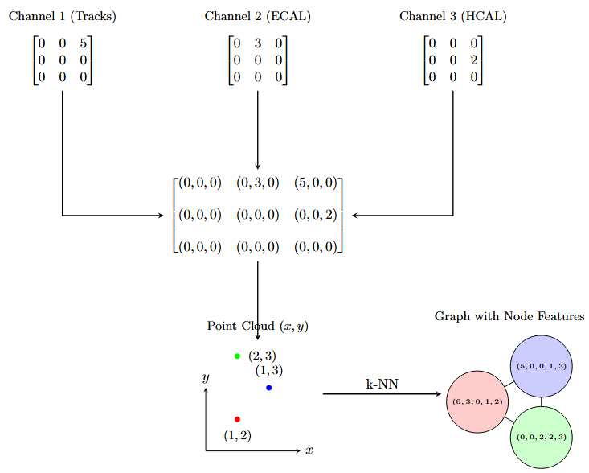
Point Cloud
‹#›

Slide 26
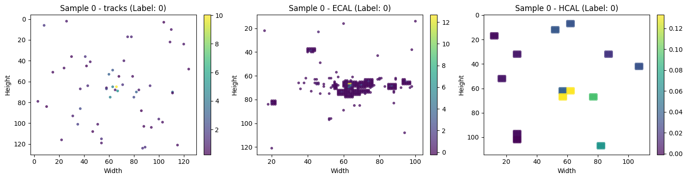
Data Representation
Convert jet images to a point cloud format by:
Removing zero pixels.
Considering any pixel with at least one non-zero value.
Using the three channel values as feature vectors.
Including the pixel’s positional coordinates.
‹#›

Slide 27
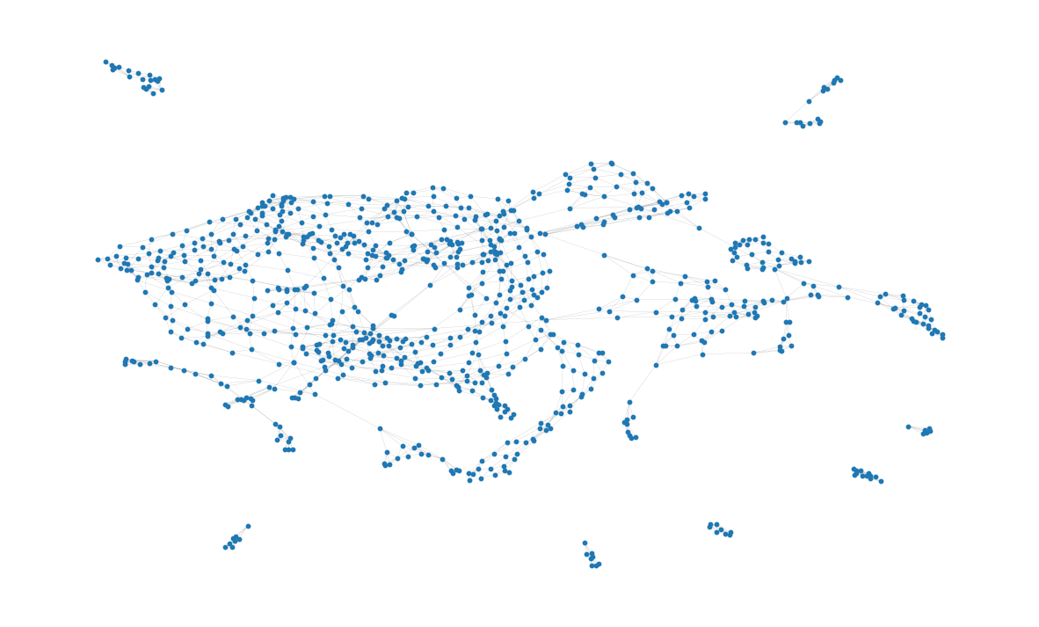
Image-to-Graph Conversion
Step 1: Identify non-zero pixels to form the point cloud. Step 2: Use each valid pixel’s 3-channel features plus its (x, y) position. Step 3: Build a k-NN graph:
Nodes represent the selected pixels.
Edges are constructed by connecting each node with its k nearest neighbors.
Edge weights computed using a Gaussian kernel (or explore alternatives like binary weights).
‹#›

Slide 28
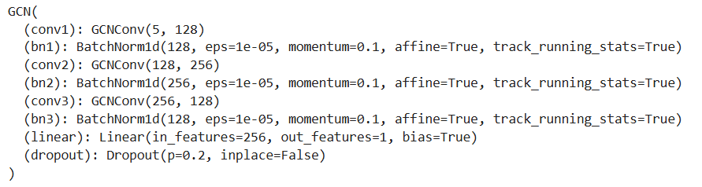
Model Architecture
Model Architecture:
A three-layer Graph Convolutional Network (GCN) with batch normalization and dropout.
Layers designed to aggregate node features from neighboring nodes.
Final classification layer outputs a probability score for quark vs. gluon jets.
‹#›

Slide 29
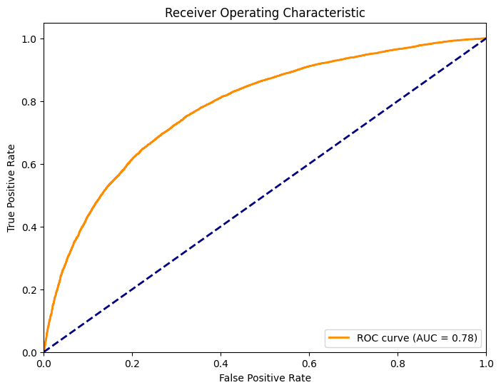
Training & Evaluation
Training & Evaluation:
Loss Function: Binary Cross-Entropy with Logits.
Metrics: Accuracy, AUC (ROC Curve).
In [12]:
Epoch 10: Train Loss:0.5638
Train Acc: 0.7159
Train AUC: 0.7818
In [12]
‹#›

Slide 30
Computational Challenges in GNNs
Irregular data structure: Since graph nodes have varying numbers of neighbors, you can't apply a uniform operation across all nodes like in CNNs; each node's neighborhood must be processed individually, making it harder to vectorize and parallelize efficiently.
Higher computational complexity: GNNs' complexity scales with the number of edges, becoming expensive for dense graphs, while CNNs have a simpler, fixed complexity per pixel or element.
Less optimized hardware support: operations in GNNs don’t fully exploit GPU parallelism, unlike CNNs’ dense operations, which are optimized by libraries like cuDNN.
‹#›

Slide 31
Summary
Graph Neural Networks (GNNs) are ideal for tasks where data forms irregular structures and relationships—such as in social networks or molecular graphs—while Convolutional Neural Networks (CNNs) excel with regular grid-like data such as images. CNNs outperform GNNs on image tasks because they are specifically designed to exploit the regular grid structure; their convolutional filters use weight sharing and local connectivity, enabling more efficient and effective feature extraction.
‹#›

Slide 32
References
A Gentle Introduction to Graph Neural Networks. Distill. distill.pub
Reliable Graph Neural Networks via Robust Aggregation. NeurIPS Proceedings. proceedings.neurips.cc
Creating Message Passing Networks. PyTorch Geometric Documentation. pytorch-geometric.readthedocs.io
A practical introduction to GNNs - Part 2. Daniele Grattarola's Blog. danielegrattarola.github.io
Graph Neural Networks: An In-Depth Introduction and Practical Applications. GeeksforGeeks.geeksforgeeks.org
A Survey on Oversmoothing in Graph Neural Networks. arXiv.arxiv.org
‹#›

Slide 33
Thank you for your attention!
01-03-2025
‹#›

